Slide 1
Smart-lock
Initial Poll
Group H

Slide 2
Initial Poll
Table of contents
Smart-lock
Objectives
Introduction
02
01
Software Design
Boundaries
04
03
Flow Chart
System Architecture
06
05
Group H
Costs
UI/UX Design
08
07

Slide 3
Table of contents
01
02
03
04
Introduction
Objectives
Boundaries
Software Design
System Architecture
Flow Chart
05
06
UI/UX Design
Costs
07
08
Advancing Security: Integrating Facial Recognition and NFC for Smart Access Control

Slide 4
01
Introduction
The Smart Lock System project focuses on developing a security solution by integrating facial recognition technology with NFC scanning capabilities.
Advancing Security: Integrating Facial Recognition and NFC for Smart Access Control
Our goal is to create a reliable system that ensures access is granted only to authorized personnel, thereby addressing concerns related to unauthorized access and security breaches.

Slide 5
Introduction
The Smart Lock System project focuses on developing a security solution by integrating facial recognition technology with NFC scanning capabilities.
02
Our goal is to create a reliable system that ensures access is granted only to authorized personnel, thereby addressing concerns related to unauthorized access and security breaches.
Objectives
Enhancing Campus Security: A Comprehensive Approach to Smart Access Control and Operational Efficiency

Slide 6
Objectives
Overview
Objective: Develop a secure, user-friendly smart lock system.
Features: Facial recognition & NFC scanning for access control.
Specific objectives
02
Security Enhancement
Operational Efficiency
User Convenience
Integration & Compatibility
Innovation & Technology
Compliance & Privacy
Enhancing Campus Security: A Comprehensive Approach to Smart Access Control and Operational Efficiency
Deliverable Focus
Fully functional prototype
Feasibility demonstration
Benefits of biometric integration in campus operation

Slide 7
Overview
Objective: Develop a secure, user-friendly smart lock system.
Features: Facial recognition & NFC scanning for access control.
Specific objectives
03
Security Enhancement
Operational Efficiency
User Convenience
Integration & Compatibility
Innovation & Technology
Compliance & Privacy
Deliverable Focus
Fully functional prototype
Feasibility demonstration
Benefits of biometric integration in campus operation
Boundaries
Building a Facial Recognition-Based Locking System: Development Timeline & Key Features

Slide 8
Boundaries
Timeline
Deliverables
Overview
List of key deliverables, including a functional prototype, software implementation, comprehensive documentation, and presentation materials.
Leveraging facial recognition technology for authentication and access control purposes.
Detailed breakdown of the nine-week development timeline from April 22 to June 21, 2024.
03
Building a Facial Recognition-Based Locking System: Development Timeline & Key Features
Key Features
Project Approach
Facial Recognition
User Database Management
Access Control
Logging and Reporting
Description of the project's approach to constructing a smart lock system
Explanation of how the
system operates
Constrains
Explanation of project limitations and constraint
Addressing potential constraints

Slide 9
Software Design
Timeline
Overview
Deliverables
Leveraging facial recognition technology for authentication and access control purposes.
Detailed breakdown of the nine-week development timeline from April 22 to June 21, 2024.
List of key deliverables, including a functional prototype, software implementation, comprehensive documentation, and presentation materials.
04
Key Features
Constrains
Project Approach
Facial Recognition
User Database Management
Access Control
Logging and Reporting
Explanation of project limitations and constraint
Addressing potential constraints
Description of the project's approach to constructing a smart lock system
Explanation of how the
system operates
Technology stack overview

Slide 10
Software Design
04
Technology stack overview

Slide 11
System Architecture
Introduction | Overview of essential technologies integral to constructing the software solution
Python | Highlighting Python as the primary programming language for software development
MySQL Database | Explanation of MySQL's role in storing employee data, including IDs and pictures
OpenCV and dlib | Introduction to OpenCV and its significance in facial recognition and image processing tasks Highlighting dlib as another powerful library for facial recognition capabilities, complementing OpenCV
Pillow | Description of Pillow's role in image processing tasks, such as resizing and cropping
PyMySQL | Explanation of PyMySQL as a Python library for interacting with MySQL databases
RPi.GPIO and Nfcpy | Introduction to RPi.GPIO for interfacing with hardware components on Raspberry Pi. Description of Nfcpy for NFC functionality in Python, enabling interaction with NFC devices
Optional/Later Technologies | Brief overview of Flask as a lightweight web framework for creating a web interface Mentioning logging options in Python and the importance of structured logging Introduction to the cryptography library for encryption operations in Python
05
Hardware Components for Door Unlocking System: A Comprehensive Overview

Slide 12
System Architecture
05
Hardware Components for Door Unlocking System: A Comprehensive Overview

Slide 13

Flowchart
Introduction | Overview of essential hardware list for the door unlocking system
Raspberry Pi 5 – 4GB | The Raspberry Pi 5 - 4GB microcomputer serves as the central hub, managing authentication requests from RFID/NFC sensors and analyzing visual input from the camera to grant or deny access
The Raspberry Pi Camera 3 | The Raspberry Pi Camera 3 is the primary authentication tool for door access, capturing images or video clips of individuals approaching the door to verify their legitimacy
Raspberry Pi 7 inch 800x480 DSI Touchscreen Display | Raspberry Pi 7-inch 800x480 DSI Touchscreen Display: This touchscreen display provides a user-friendly interface for configuring the door unlocking system
The Raspberry Pi Display Cable | The Raspberry Pi Display Cable - Standard-Mini - 200mm is a component that facilitates the connection between the Raspberry Pi microcomputer and the touchscreen display
PN532 NFC/RFID Controller Breakout Board & 13.56MHz RFID/NFC card | Integrated with a 13.56MHz RFID/NFC card reader, the PN532 NFC/RFID Controller Breakout Board detects authorized RFID tags or NFC-enabled devices, granting access by activating the door unlocking mechanism upon validation of a valid tag
Grove – Servo | The Grove - Servo module is vital for automating door functions, facilitating precise opening and closing movements. Integrated into door control systems, this servo motor delivers the required mechanical force to operate the door mechanism smoothly and accurately.
The Power Supply / Connectivity to socket | The Power Supply / Connectivity to the socket part is like the heart of the system, making sure everything stays running by giving power to all the connected devices.
06
Lock opening process

Slide 14
06
Flowchart
Lock opening process

Slide 15
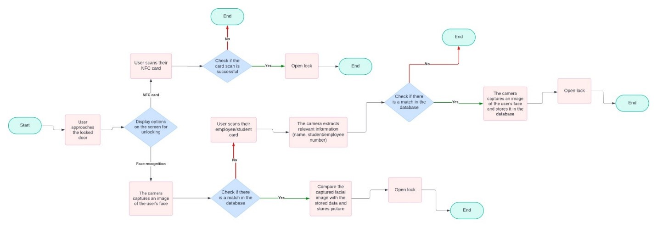
UI/UX Design
07
Exterior design and software interface

Slide 16
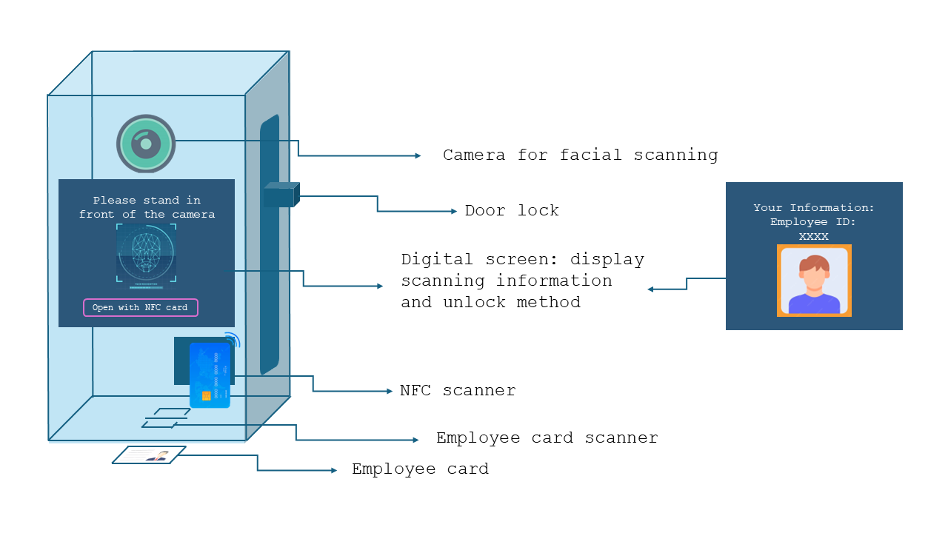
UI/UX Design
07
Exterior design and software interface
Exterior design of the smart lock

Slide 17
Exterior design of the smart lock

Slide 18
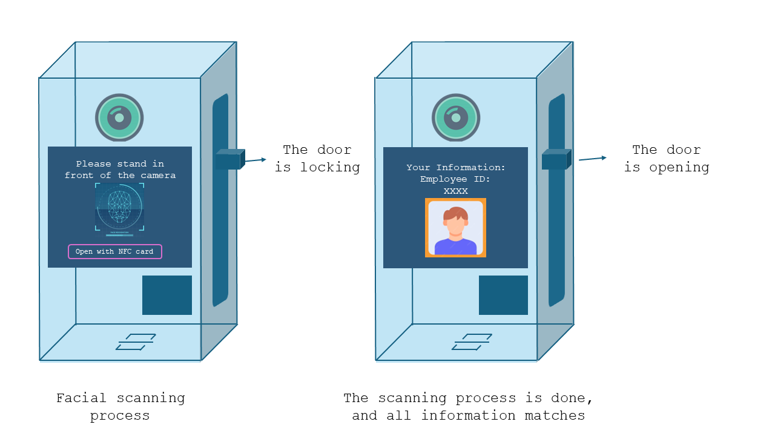
Lock operation with facial recognition

Slide 19
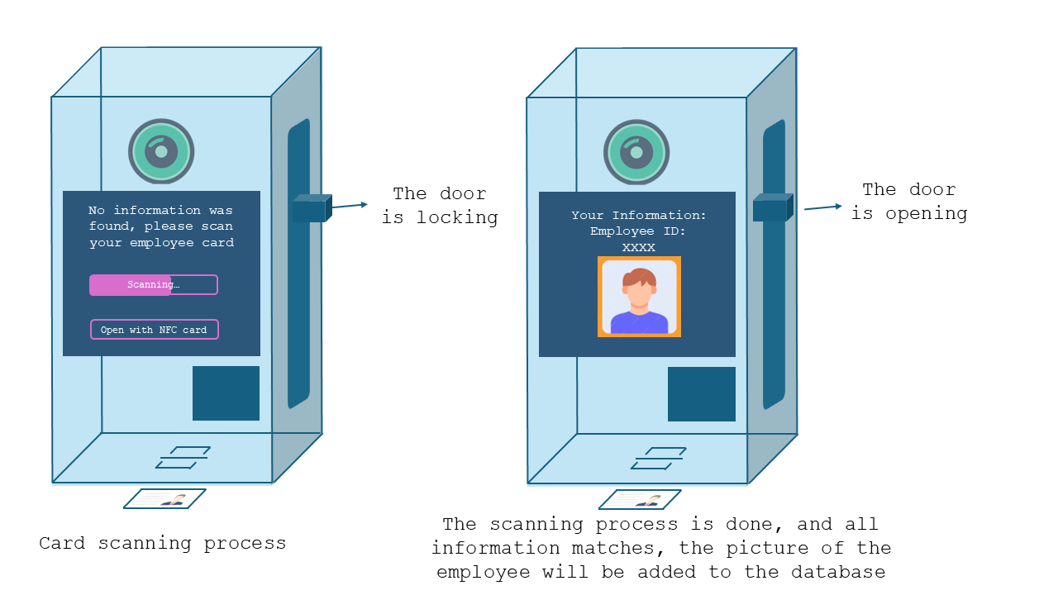
Lock operation with facial recognition and card reading

Slide 20
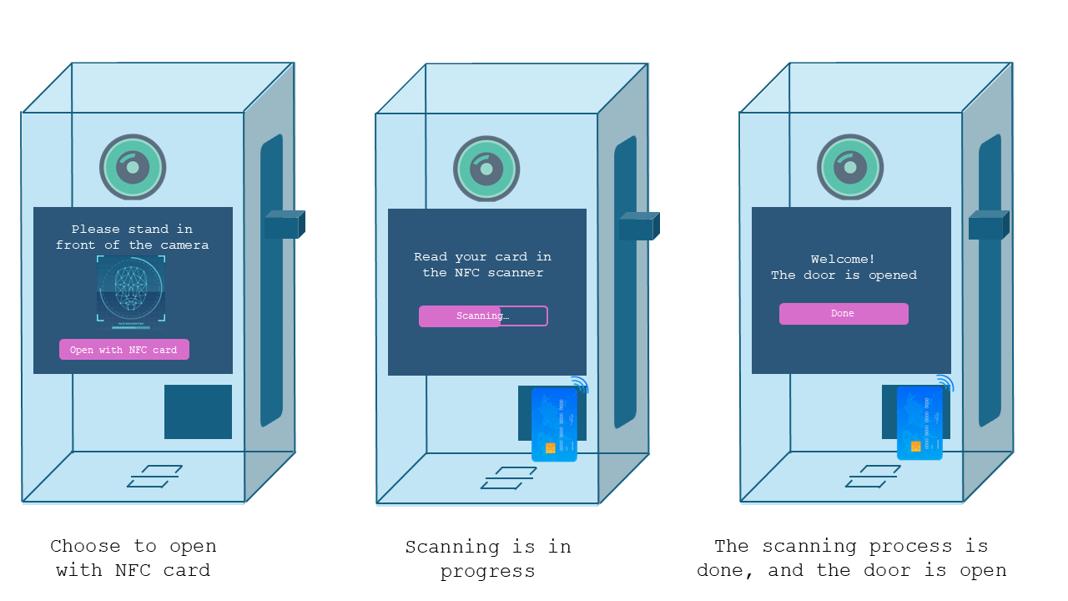
Lock operation with NFC card reading

Slide 21
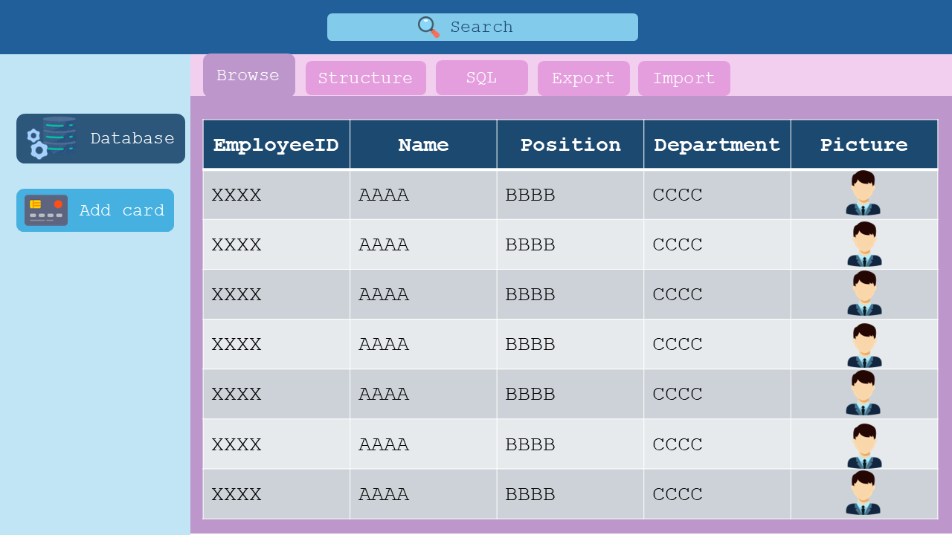

Slide 22
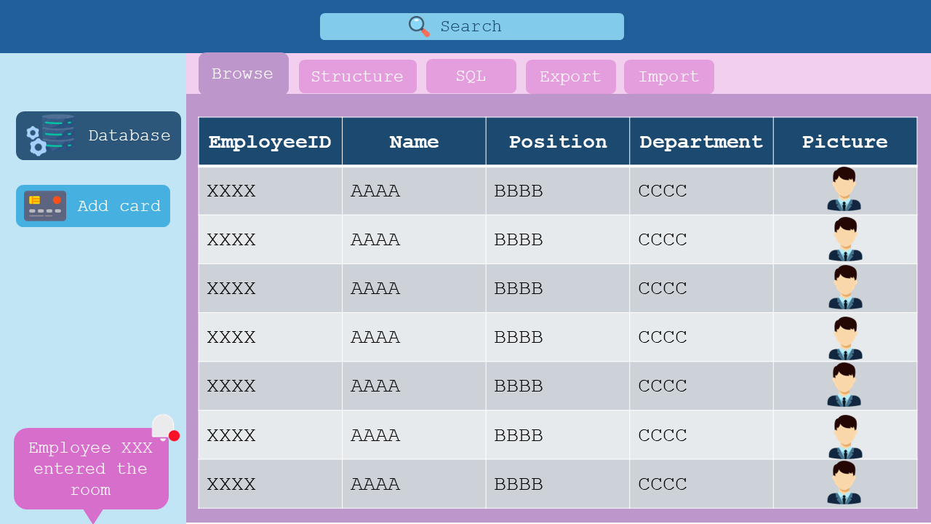

Slide 23
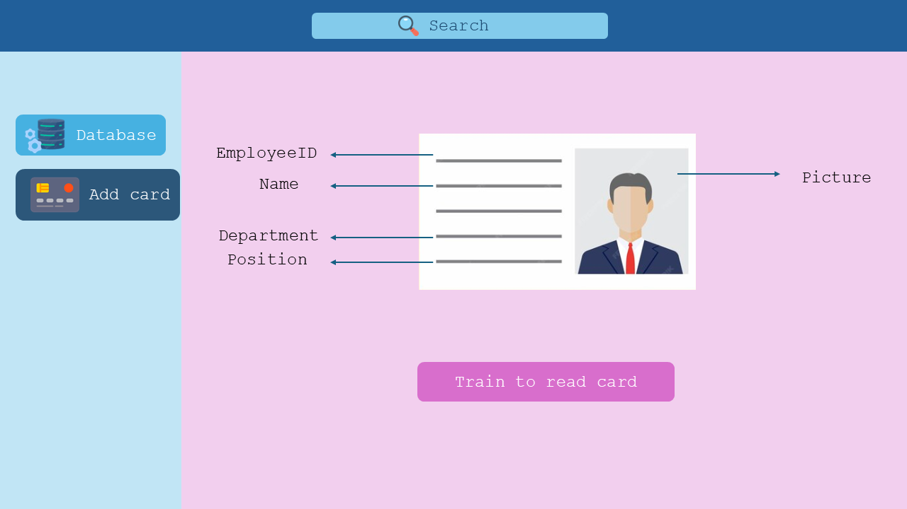
08
Costs
Hardware Expenses: Cost Breakdown for Door Unlocking System Components

Slide 24
Costs
08
Hardware Expenses: Cost Breakdown for Door Unlocking System Components

Slide 25
Name | Price | Link
Raspberry Pi 5 – 4GB | € 64.95 | https://www.kiwi-electronics.com/en/raspberry-pi-boards-cases-addons-and-accessories-59/raspberry-pi-5-4gb-11579
Raspberry Pi Camera 3 | € 29.95 | https://www.kiwi-electronics.com/en/raspberry-pi-boards-cases-addons-and-accessories-59/raspberry-pi-camera-3-11239
Raspberry Pi 7 inch 800x480 DSI Touchscreen Display | € 74,95 | https://www.kiwi-electronics.com/en/raspberry-pi-boards-cases-addons-and-accessories-59/raspberry-pi-7quot-800x480-dsi-touchscreen-display-1948
Raspberry Pi Display Cable - Standard-Mini – 200mm | € 1.25 | https://www.kiwi-electronics.com/en/raspberry-pi-display-cable-standard-mini-200mm-11591?search=display%20kabel
PN532 NFC/RFID controller breakout board - v1.6 | € 44,95 | https://www.kiwi-electronics.com/en/pn532-nfc-rfid-controller-breakout-board-v1-6-616?search=nfc
Total costs: € 242,2

Slide 26
Thanks!
Name | Price | Link
13.56MHz RFID/NFC card – 1KB | € 2,95 | https://www.kiwi-electronics.com/en/13-56mhz-rfid-nfc-kaart-1kb-863?search=nfc
Grove – Servo | € 8,25 | https://www.kiwi-electronics.com/en/grove-servo-2070?search=servo%20motor
Power Supply / Connectivity to socket | € 14,95 | https://www.kiwi-electronics.com/en/argon-pwr-gan-usb-c-pd-27w-for-rpi-5-eu-plug-20012?search=power%20supply%20for%20raspberry%20pi%205
Delivery | Free
Total costs: € 242,2
Do you have any questions?

Slide 27
Thanks!
Do you have any questions?

